Slide 1
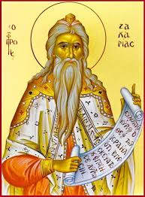
LESSON 10
PROPHET HAGGAI
PROPHET ZECHARIAH
Notes:
MORAL

Slide 2
AIM
1) Gods' "instrument of salvation" for the exiled Jews was King Cyrus of
Persia who defeated the Babylonians in 539 BC.
2) Return from exile. God's people coming back together.
3) Rebuilding of the Temple.
4) Correcting the people's priorities.
5) Revival guided by the Torah.
6) Prophets Haggai and Zechariah guided the people to give God the first place
in their lives.
Notes:
MORAL

Slide 3
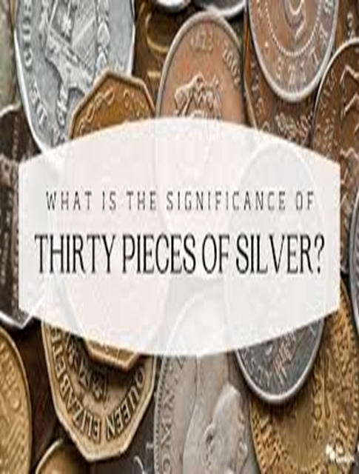
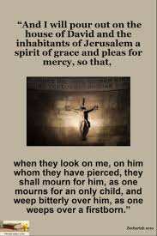
SPIRITUAL READINGS
Haggai - Chapters 1 & 2
Zechariah - Chapters 1 to 6 - Eight Visions of Zechariah
- Chapter 11: 4-17 - The Prophet speaks of a payment
involving 30 pieces of silver and of a good shepherd
whose service is brought to an end.
- But lets hear v:12-13 -
V12 I then said to them, "if it seems right to you,
give me my wages; but if not keep them". So they weighed
out as my wages thirty shekels of silver.
V13 Then the Lord said "Throw it into the treasury."
- this lordly price at which I WAS VALUED BY THEM.
So, I took the THIRTY SHEKELS OF SILVER and THREW THEM INTO THE TREASUREY IN THE HOUSE OF THE LORD. (Relates to Mathew 26:15 & 27:5-7 )
Chapter 12: 10 - "And I will pour out a spirit of compassion and supplication on the house of David and the inhabitants of Jerusalem, so that, when THEY LOOK ON THE ONE WHOM THEY HAVE PIERCED; THEY WILL MOURN FOR HIM, AS ONE MOURNS FOR AN ONLY CHILD, and weep bitterly over him, as one weeps over a first born.

Slide 4
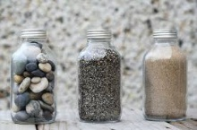





Human Experience :
Any one is willing to give Testimony on giving priority to Catechism Classes, and God and God's work, over other engagements?? even while in Class X and even while studying for the SSC examination??
A Professor of Philosophy stood before his class with some items in front of him.
When his class began, he picked up a large empty Jar a and proceeded to fill it with Rocks
about two inches in diameter. He then asked the students if the jar was full.
They agreed that it was full.
So the professor then picked up a box of Pebbles and poured them into the jar.
He shook the jar lightly and watched as the Pebbles rolled into the open areas between the Rocks.
The professor then asked the students again if the jar was full.
They chuckled and agreed that it was indeed full this time.
The professor then picked Sand & poured into the jar. The Sand filled remaining open areas of the jar.
'Now', said the professor, "I want you to recognize that this jar signifies your life.
The Rocks are the truly important things, such as God, Prayer, Our Faith & Spiritual Being.
If all else was lost and only the Rock remained, your life would still be meaningful.
The Pebbles are the other things that matter in your life, such as Family, Relations, Work or School.
The Sand signifies the remaining 'small stuff' and material possessions.

Slide 5
LESSON :
Now observe if you put Sand into the jar first, there is no room for the Rocks or the Pebbles.
The same can be applied to your lives.
If you spend all your time and energy on the small stuff, you will never have room for the things that are truly important in life such as God, Prayer, Church, etc.
Things to ponder :
Attending weekly Mass or Adoration on First Saturday of every month
-over avoid attending due to laziness or other distractions ?
Not have time for Prayers, Bible Reading, Mass, Rosary,
-over time spent daily on entertainments like playing games/Internet/Phone/TV
As followers of Jesus, we are called to use our gifts to serve other.
In this world, we are His hands and feet, His eyes and ears, His mind and heart
-do we use these talents for our self or engage in Church activities or organizations to help others ?
Bible verse to remember ;: MATHEW 6:3
""BUT SEEK FIRST THE KINGDOM OF GOD AND HIS RIGHTEOUSNESS,
AND ALL THESE THINGS SHALL BE ADDED TO YOU.""

Slide 6
Would you children continue attending class when you go to Standard X or Standard XI ?
Would you children find it difficult to attend Catechism Class because of your studies ?
____________________________________________________________________________________
Well, I will now tell you about the choice Blossom, an average X Standard student, has to make.
Blossom has been in the Junior Legion nearly 8years ago and she enjoys her weekly meeting and one-hour of visiting the sick.
But now that she will go to Standard XI next year, her parents want her to stop being a Legionary, and also to stop attending Catechism.
Let us find out the possible reasons why her parents are asking Blossom to stop Legion work and also stop attending Catechism.
Let us also find valid arguments as t why it is proper for Blossom to continue Catechism and in the Legion.
Well, finally, the real decision that you all will be making depending upon the place that we give God in our lives.
Similarly, we are invited to reflect on the experience of the Jews, our fore fathers in faith, to see how they were taught to put God first in their lives.

Slide 7
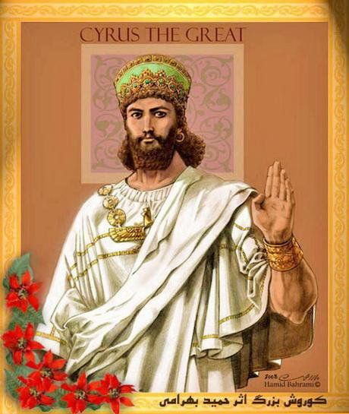
DEVELOPMENT :
Persian kings as instruments in Yahweh's hands.
A) King Cyrus captures Babylon and allows the exiles to return.
The prophecies of Prophet Isaiah and Jeremiah on destruction of Babylon came true & Ezekiel's prophesy of return to Jerusalem is now coming to pass. The Babylonian empire was destroyed by a new coalition of Medes and Persians.
The victory of Cyrus the Persian in the year 539 BC was welcomed by the downtrodden people of the Babylonian empire.
The Jews saw the hand of god ( and their prophet's words fulfilled),
in the coming of Cyrus; and he did not disappoint them.
The Assyrians and Babylonians had ruled their empires with an iron fist.
Cyrus decided to rule with tolerance and kindness. In 538 he allowed the Jews to return to their homeland.
Now they could start to rebuild the Temple. It seems that Cyrus even subsidized the cost of the rebuilding and sent back all the Temple vessels confiscated by Nebuchadnezzar.
No wonder the Jews saw Cyrus as their Savior.

Slide 8
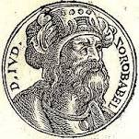
B) Initial excitement slowly vanishes ;
However, not all was well with the returning exiles. One of the outstanding leaders under whom the return and restoration took place was Zerubbabel, a descendant of David.
The people took several months to settle down; most had to face the problems of finding somewhere to live and restoring their badly neglected land to a good state before they could think of rebuilding the Temple.
After sometime when the people began the rebuilding of the new Temple's foundation, their zeal diminished.
The local residents and a few others began to show their displeasure at the return of the exiles.
Even the neighboring groups did all they could to hinder the repair work. A further setback came from several years of poor harvest which the settlers had to contend with.
And so the people began to discuss whether this was the time to rebuild the Temple, and the general feeling was that they could not afford to do it just now. So over the next eighteen years, nothing was done.
The community became dispirited to keep going; the bright hopes and the high expectations of the early days vanished.
Zerubbabel was a governor of the Achaemenid Empire's province Yehud Medinata and the grandson of Jeconiah the penultimate king of Judah.

Slide 9
C; Prophets Haggai and Zechariah correct the people's priorities
About this time, approximately 520 B.C. two new prophets, Haggai and Zechariah, started speaking out. They knew that the community had become depressed and disheartened and that if the people were to survive, they had to get back their confidence in God. Some of the returned exiles had been so concerned to get land for themselves and build up their own estates that they hand left the Temple building on one side as a matter of low priority (Haggai 1:4, 2:15-19).
Haggai could see that they had lost their community spirit.
He challenged them to put God first in their lives and explained that the difficulties they experienced were a punishment for concentrating on their own houses while God's house still lay in ruins (Haggai 1:4). He encouraged them to hope that the completion of the Temple would turn the tide, so that great blessing would come on the community (Haggai 2:-9)
The prophet Zechariah began his mission only a few months after Haggai.
He confirms Haggai's message after a series of visions he receives from God, in which he became convinced that the rebuilding of the Temple was of utmost importance for a true revival of the community.
Encouraged by the prophets, perhaps a little shamefaced at their failure to act earlier, the company of returned exiles took fresh heart. With a new sense of motivation, in 520 BC the building of the Temple was recommended by Zerubabel. Four years later, in 516 BC it was at last finished.
The new building was dedicated with great ceremony and rejoicing. It drew all the people together, the priesthood was re-organized and strengthened, and now formal worship in the new state could really begin.
The new Temple however was not as big, and nowhere near as magnificent, as Solomon's Temple had been.

Slide 10
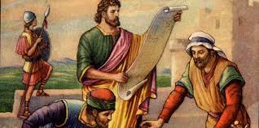
D. A revival guided by the Torah.
Once the Temple was rebuilt, it proved the much-required focus for the revival of the entire nation.
In 458 BC, the priests Ezra came to Jerusalem to spearhead a revival of the cult basing himself on the book of the law of Moses.
In 445 B.C under the leadership of Nehemiah, the Jews rebuilt the wall of Jerusalem.
By and large there was a desire to remain faithful of God's law and to pattern their entire lives according to it. The temple of Jerusalem would however reach another peak of its glory only under Herod the Great, about four centuries later.
2. The significance of these events:
Judah never again really existed as a fully independent nations, nor did it have its own king to hold it together.
But the rebuilding of the Temple and the work of Ezra and Nehemiah had strengthened the people's sense of identity and given them a focus to revive as a nation.
Sometimes their emphasis on God's law took the form of an over-emphasis on the ritual laws, forgetting the prophets' reminders that the covenant is necessarily of the heart. However, the people had a sense of a true community that God wanted them to be, and began to expect the Savior that would finally put a complete end to their problems.
That hope was possible to be filled only in Jesus.
Ezra, Hebrew ʿezraʾ, (flourished 4th century bc, Babylon and Jerusalem), religious leader of the Jews who returned from exile in Babylon, reformer who reconstituted the Jewish community on the basis of the Torah (Law, or the regulations of the first five books of the Old Testament).
Nehemiah is the central figure of the Book of Nehemiah, which describes his work in rebuilding Jerusalem during the Second Temple period. He was governor of Persian Judea under Artaxerxes I of Persia. The name is pronounced or in English. It is in Hebrew נְחֶמְיָה‎, Nəḥemyāh, "Yah comforts"

Slide 11
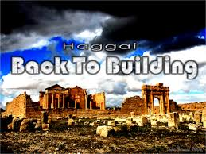
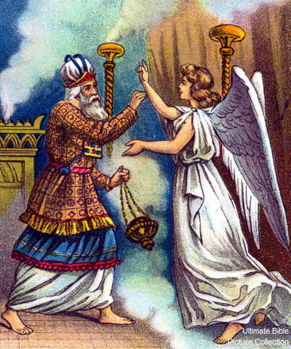
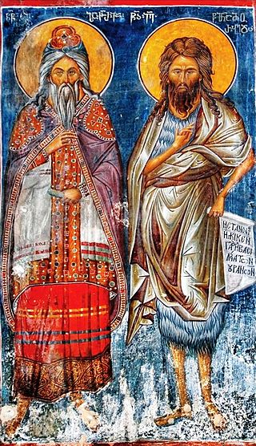

Slide 12
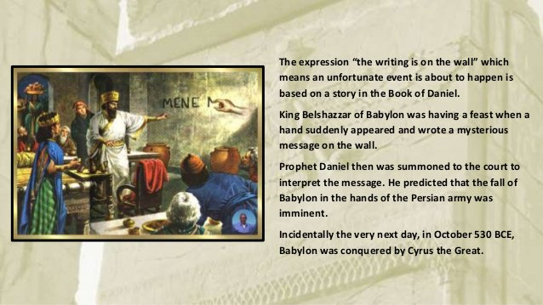

Slide 13
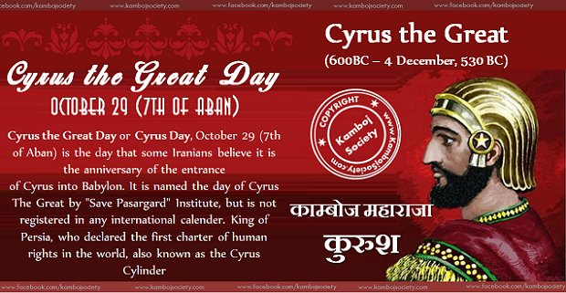

Slide 14
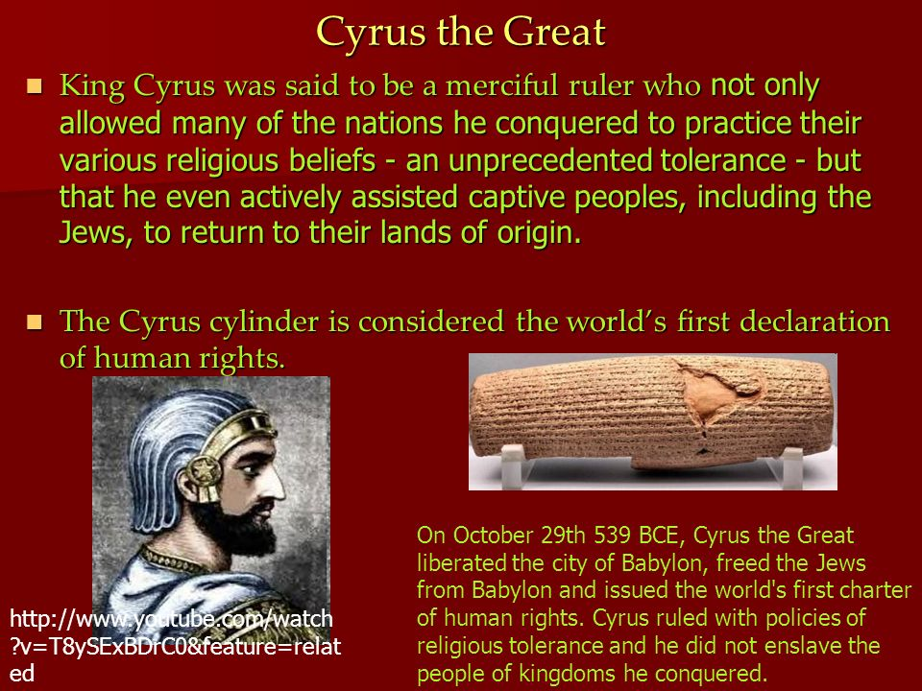

Slide 15
WORD OF GOD - HAGGAI 1:3 to 11
Then the word of the Lord came by the prophet Haggai saying;
Is it a time for you yourselves to live in your paneled houses, while this house lies in ruins?
Now therefore thus says the LORD of hosts: Consider how you have faired.
You have sown much, and harvested little; you eat, but you never have enough;
you drink, but you never have your fill; you clothe yourselves, but no one is warm;
and you that earn wages earn wages to put them into a bag with holes.
Thus says the LORD of hosts: Consider how you have faired.
Go up to the hills and bring wood and build the house,
so that I may take pleasure in it and be honored, says the LORD.
You have looked for much, and lo, it came too little;
and when you brought it home, I blew it away.
Why? Says the LORD of hosts.
Because my house lies in ruins, while all of you hurry off to your own houses.
Therefore, the heavens above you have withheld the dew,
and the earth has withheld its produce.
And I have called for a drought on the land and the hills,
on the grain, the new wine, the oil, on what the soil produces,
on human beings and animals; and on all their labors.
The word of the Lord. Thanks be to God.

Slide 16
Responsorial Psalm (Psalm126 or Psalm 125 in lectionary)
https://www.youtube.com/watch?v=21yISx2L7sU

Slide 17
2 minutes
https://www.youtube.com/watch?v=Lf7j_t9k_v4

Slide 18
https://www.youtube.com/watch?v=0wO3Sxlidp0

Slide 19

CLOSING PRAYER

Slide 20


