Slide 1
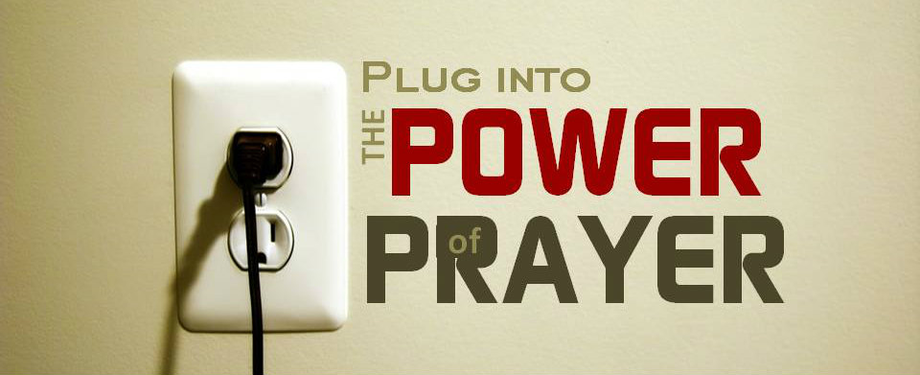

Slide 5
Words spoken difficult to take back just like scattered feathers

Slide 7
We damage by saying lies
Lying is deliberate
To cover one lie we say series of lies
When we say lies trust breaks

Slide 8
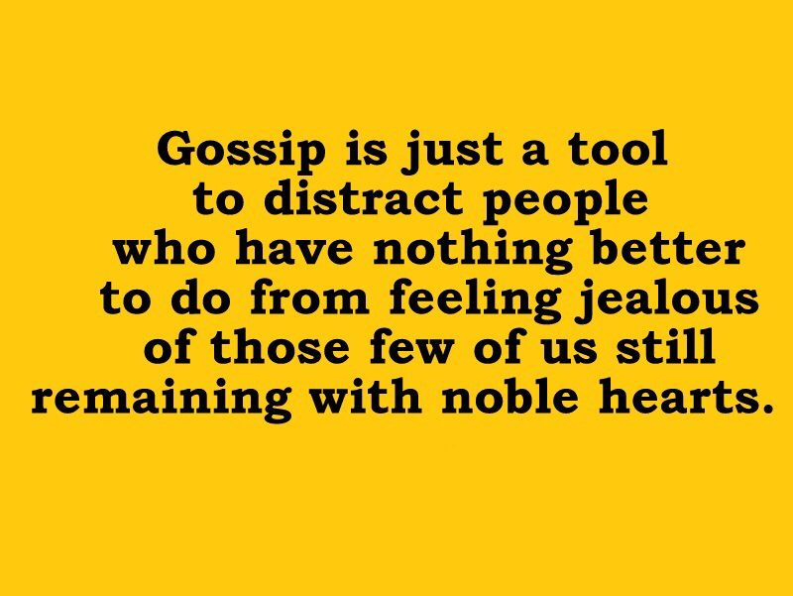
Gossiping spoils another’s name

Slide 9
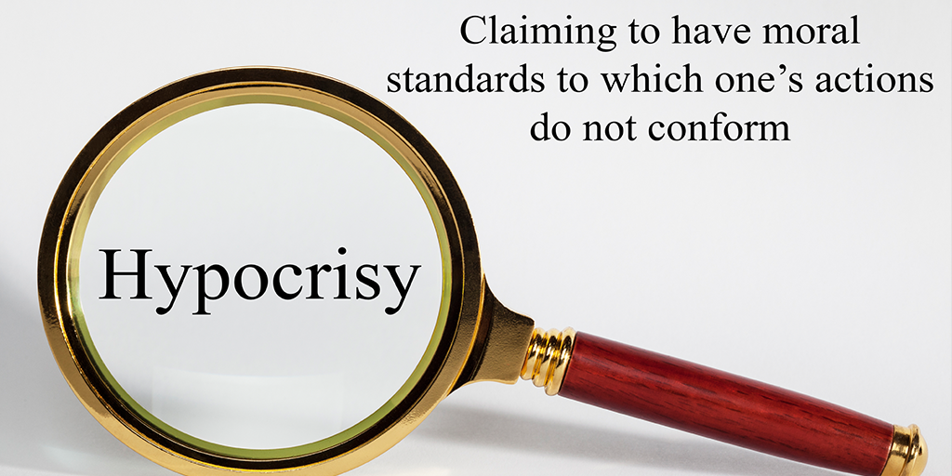
Rash judgment and Hypocrisy
Judging another person’s character on flimsy evidence - we should be very slow to judge
Hypocrisy is pretending to be better than who we really are

Slide 10
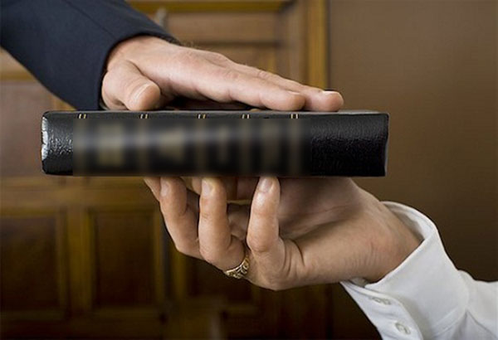
Oath and promises
Keeping the promises made is very important aspect
false oath is sinful- because when we are lying we call on God as witness
Perjury is when we lie under an oath

Slide 11
Sin of saying something wrong about another is called slander
Detraction is using the truth to harm others
when we say or hear something ask ourselves whether it is helping others , whether it is good or truth

Slide 12
How much you have learnt ….. ???
1. Idle talk about the faults of others | a. Slander/ calumny
2. Lying under oath | b. Detraction
3. Saying something false about another | c. Rash judgment
4. Pretending to be better than you are | d. Gossip
5. Judging another’s character without enough evidence | e. Hypocrisy
6. Deliberately deceiving someone | f. Lying
7. Using the truth to harm another | g. Perjury

