Slide 1
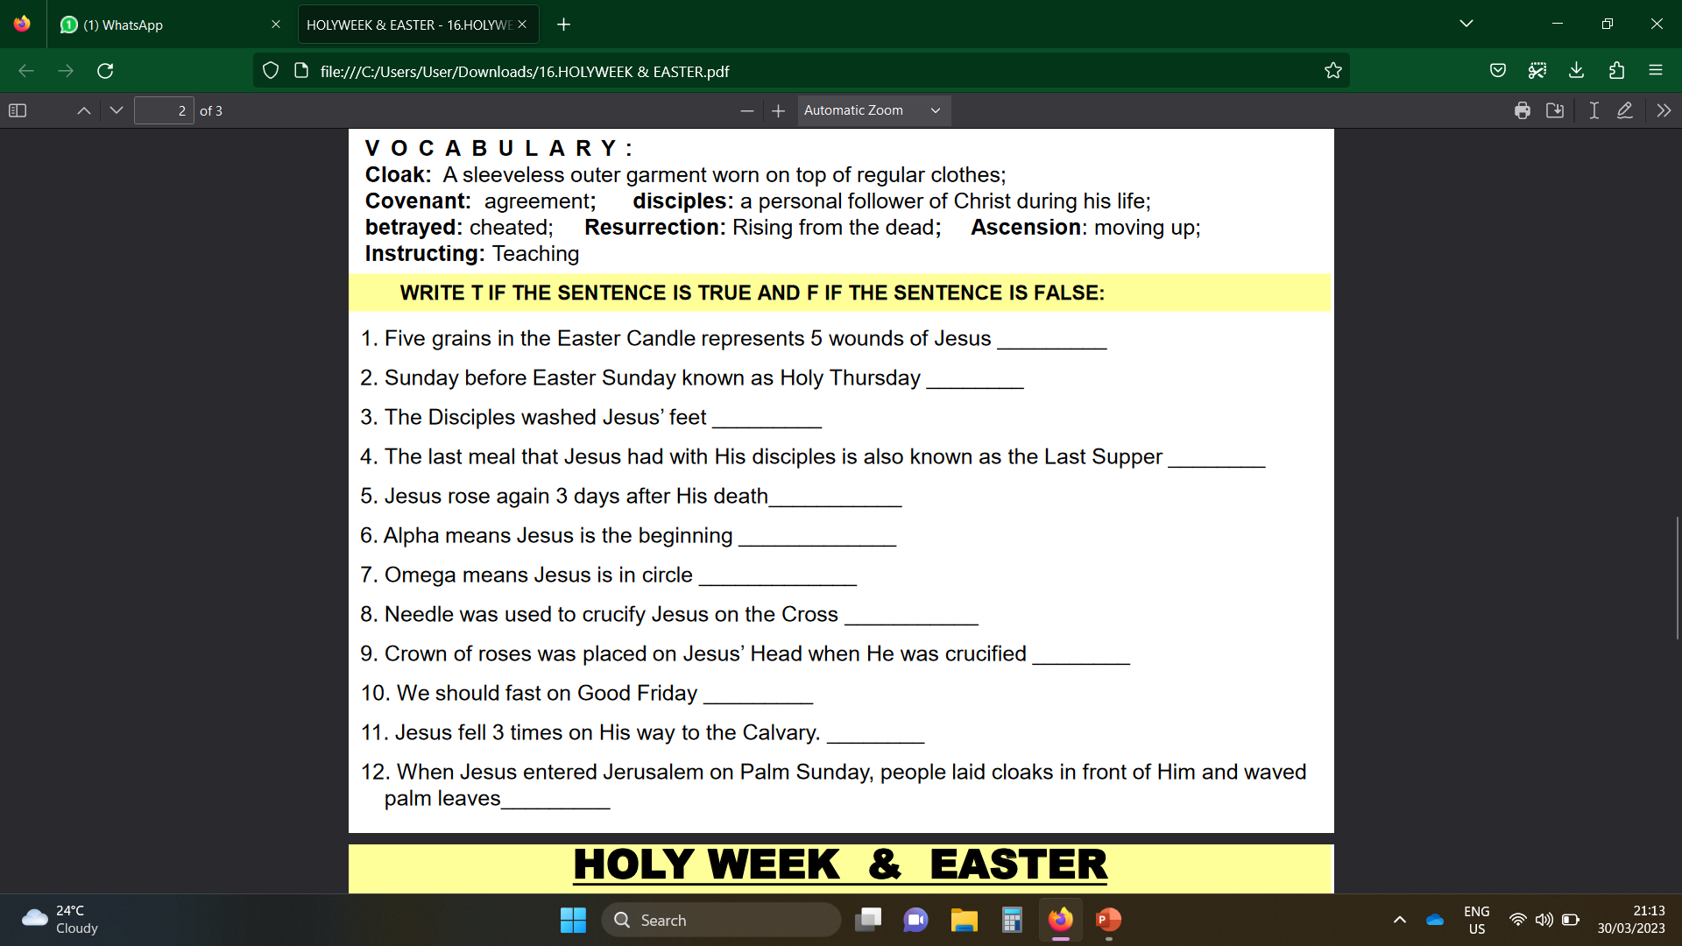
Exercises
True
False
False
True
True
True
False
False
False
True
True
True

Slide 2
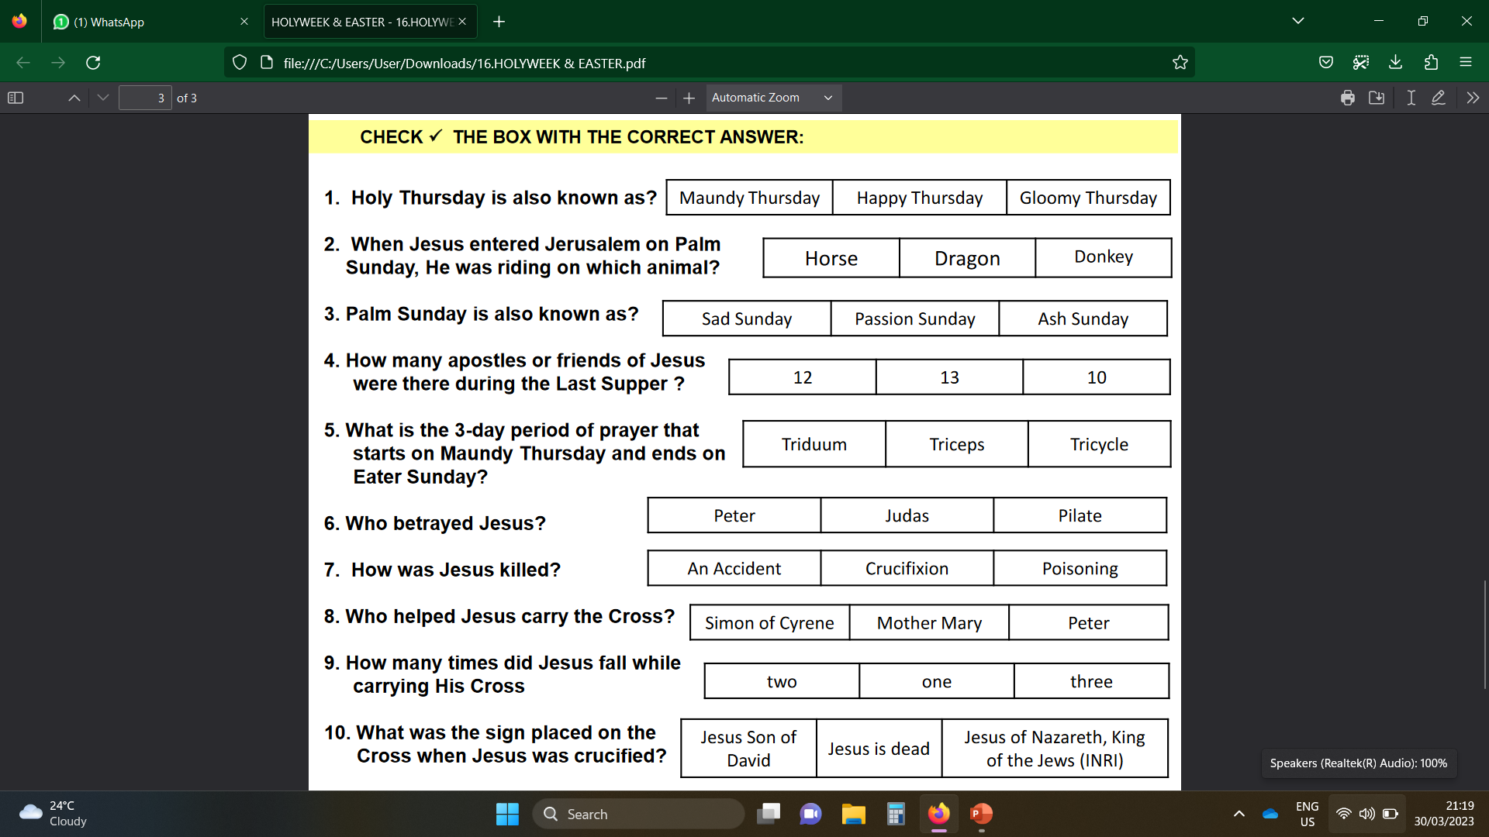

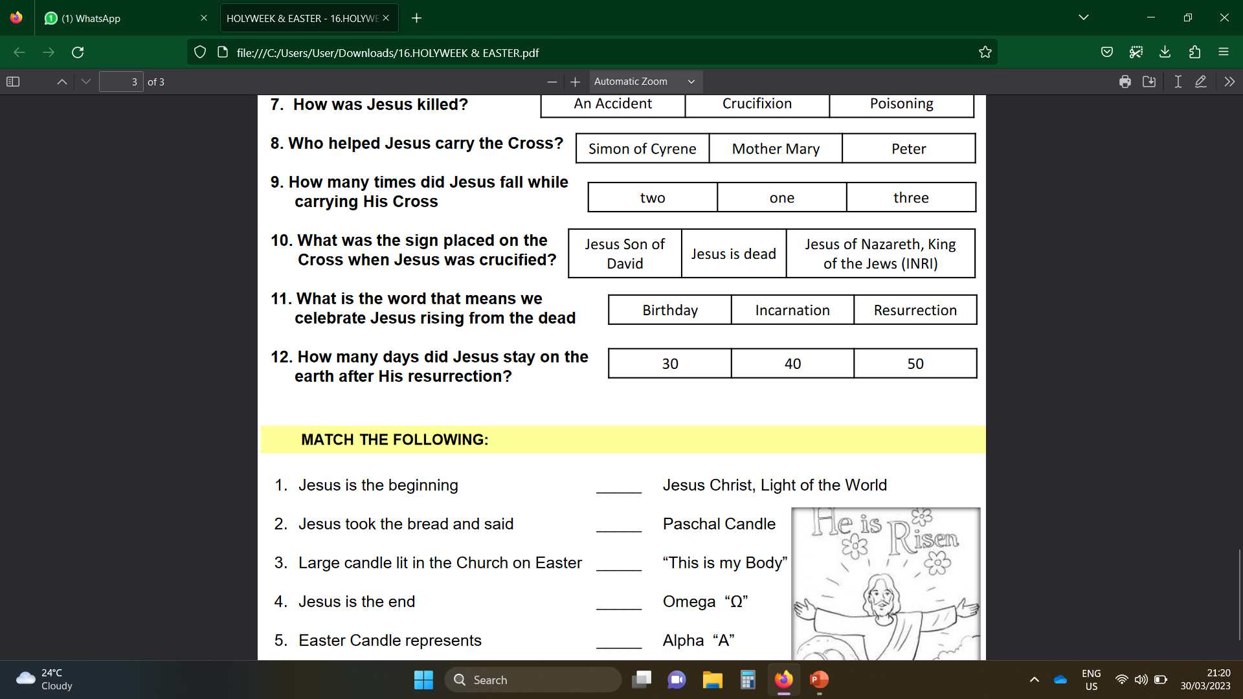

Slide 3
1. Jesus is the beginning E A. Jesus Christ, Light of the World
2. Jesus took the bread and said C B. Paschal Candle
3. Large candle lit in the Church on Easter B C. “This is my Body”
4. Jesus is the end D D. Omega “Ω”
5. Easter Candle represents A E. Alpha “A”

Slide 4
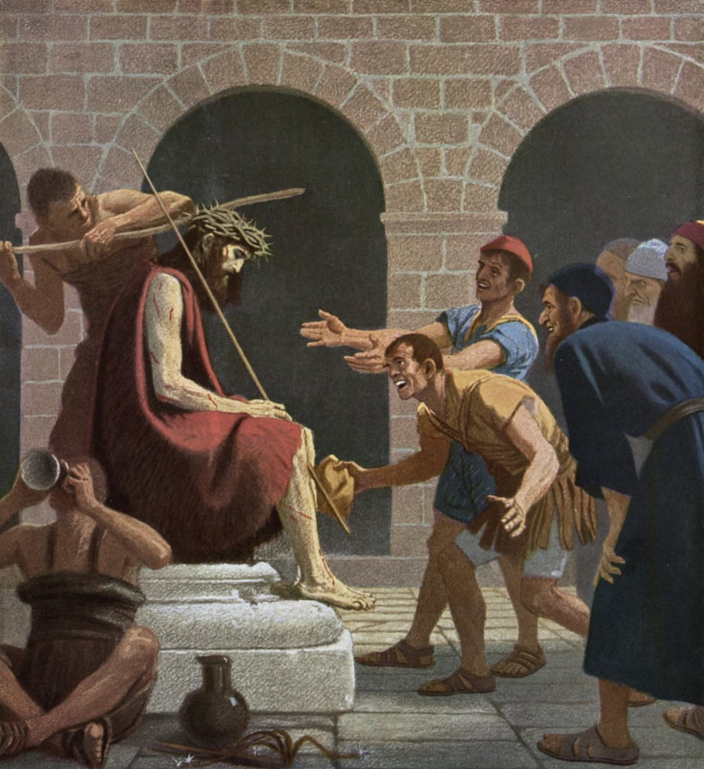
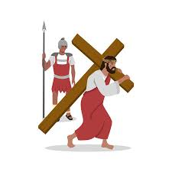
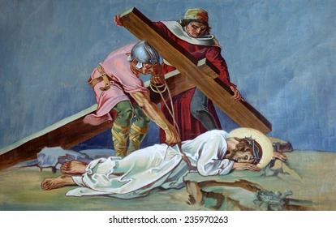
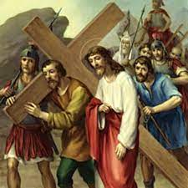
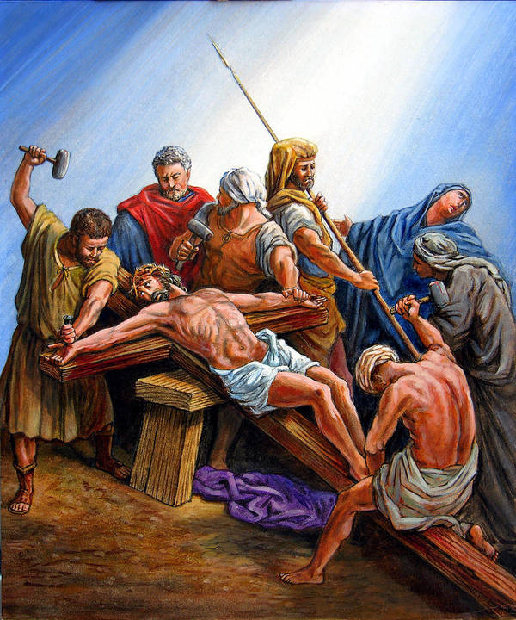
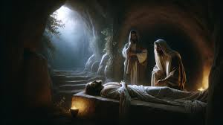
Number the brackets Correctly:
4
6
1
Simon of Cyrene helps Jesus carry the Cross | Jesus is laid in a tomb | Jesus is Crowned with Thorns
Jesus Falls on the ground 3 times | Jesus Carries The Cross | Jesus is nailed to the Cross & Crucified
3
2
5
2
3
1
4
5
6

Slide 5
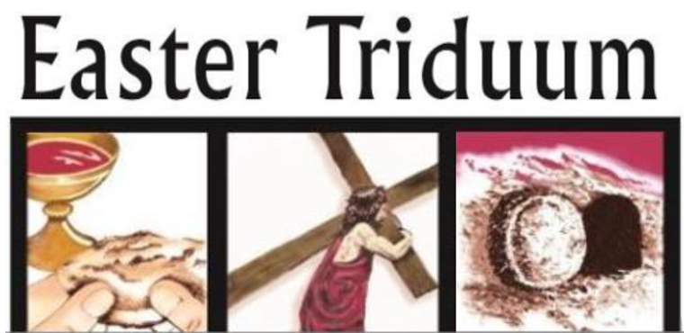
TRIDUUM
A 3-day period of prayer starting from Maundy Thursday and ends on Easter Sunday.
Maundy Thursday
Easter Sunday
Good Friday

Slide 6
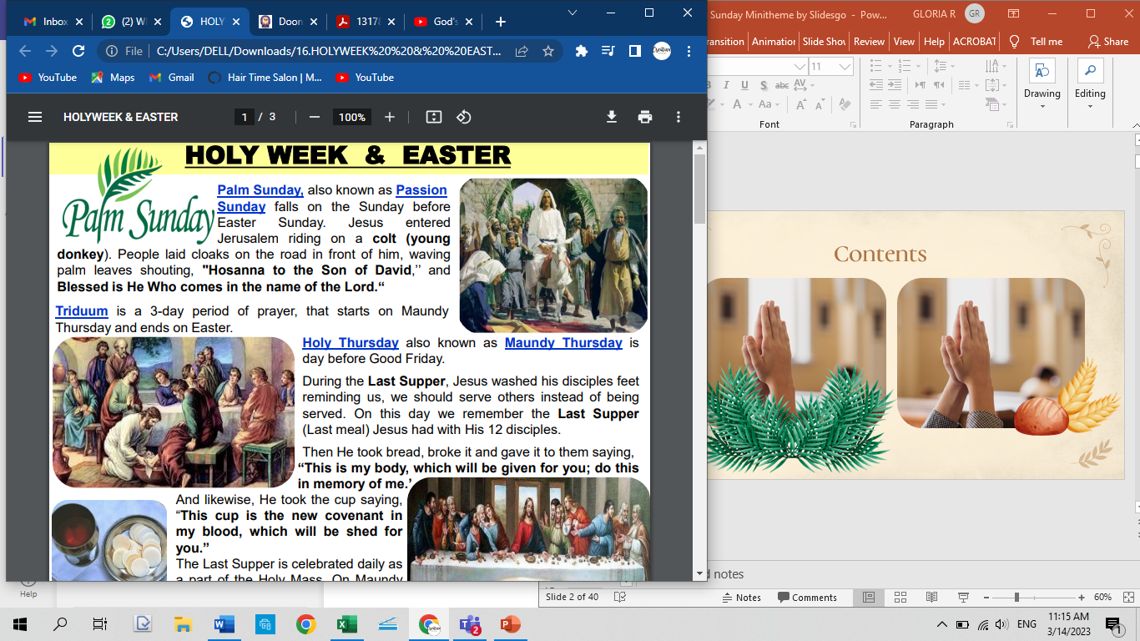
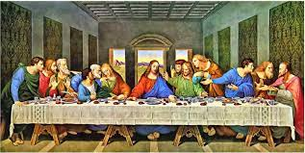
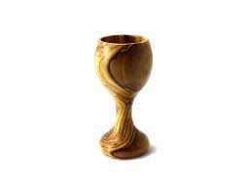

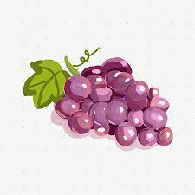
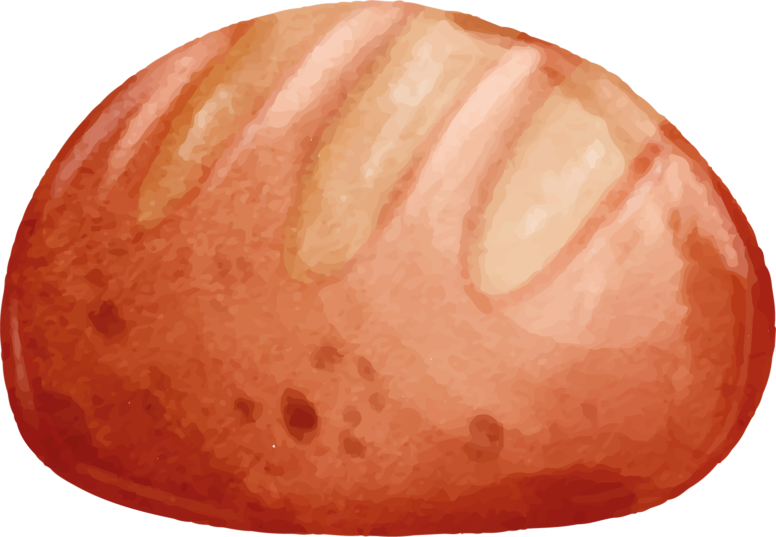
Maundy Thursday / Holy Thursday
Jesus washed his disciples feet reminding us, we should serve others instead of being served.
“This is my body which will be given for you, do this in memory of me”
The Last Supper with his 12 disciples
“This cup is a new covenant in my blood, which will be shed for you”

Slide 7
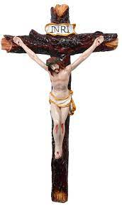
Good Friday
INRI
Jesus of Nazareth, King Of The Jews
Jesus is scourged, beaten and crowned with thorns
Jesus was Forced to carry the cross to the Calvary.
Simon of Cyrene helped Jesus carry his cross.
Jesus falls three times on his way to Calvary
Jesus is laid in a tomb
Jesus is nailed to the Cross and Crucified
Why is it called Good Friday?
Because Jesus Christ chose to die for our sins so that we can be with him in heaven forever

Slide 8
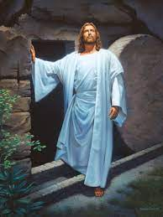
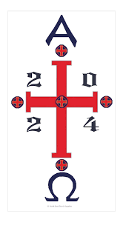
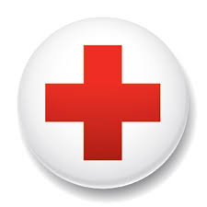
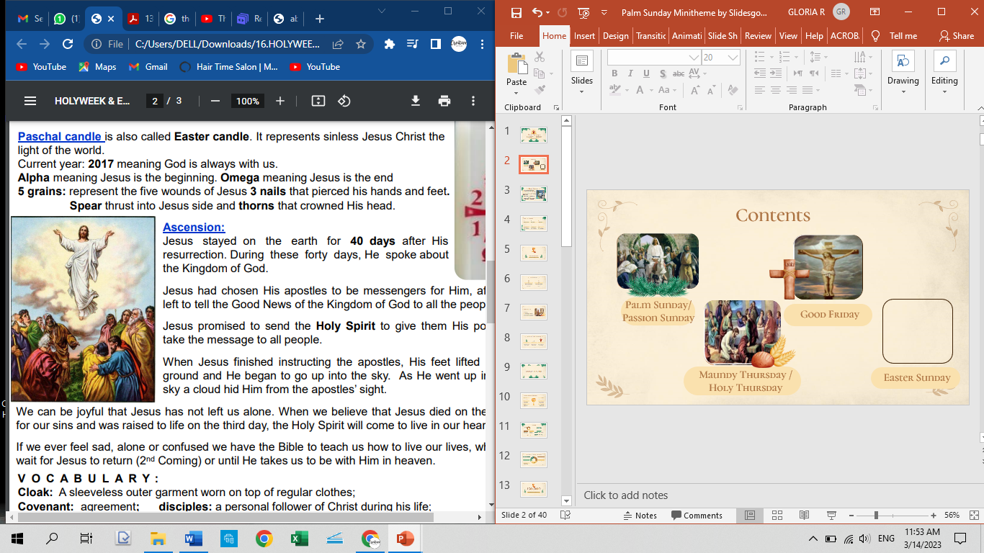
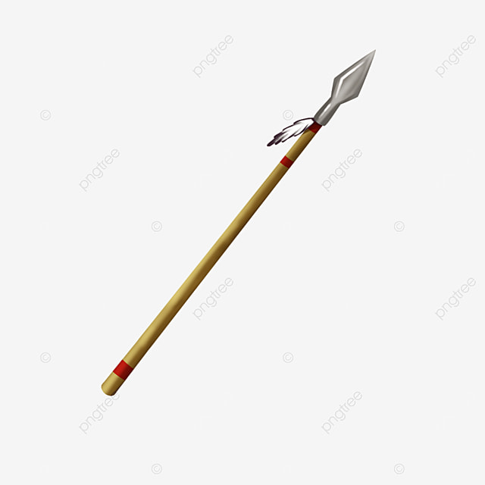
Easter Sunday
Pascal Candle / Easter Candle
EASTER GREETINGS
“Alleluia, the Lord is risen!”
“He is risen indeed!”
ALPHA – Beginning
Resurrection is the rising of Jesus three days after His death. His tomb was empty.
OMEGA – End
The 5 Grains (wounds of Jesus)
Ascension - Jesus is taken up into heaven.
Spear
Thorns Crown
3 Nails

