Slide 1
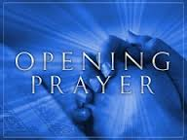

Slide 2
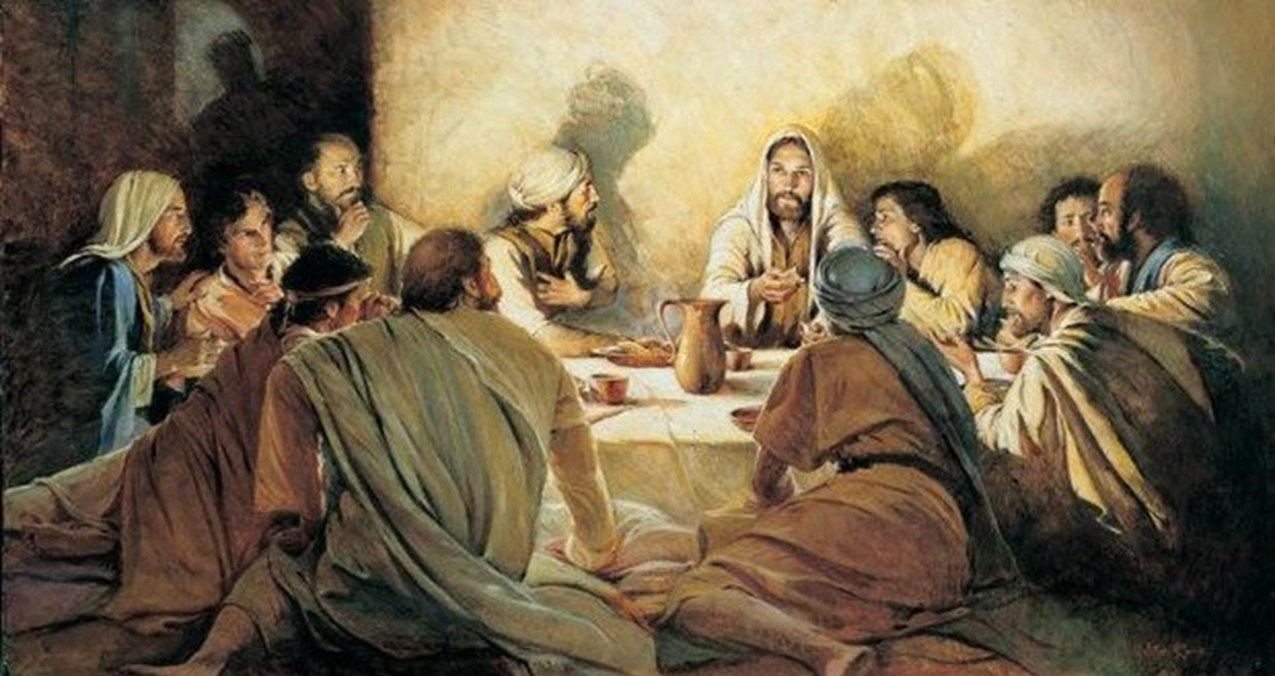
The Living Sacrifice

Slide 3
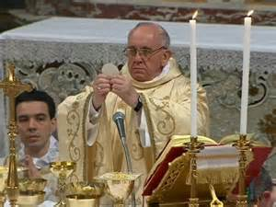
Jesus’ workers continue to do this in memory of Him

Slide 4
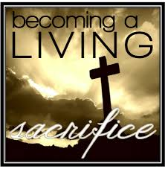
Notes:
Jesus gave his life for us on the cross and became a living sacrifice for our sins and rose again from the dead.

Slide 5
Reasons for the Eucharist
For us to have an acceptable sacrifice to offer continually to God our Father.
For us to have eternal life

Slide 6
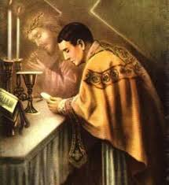
What do you see in the image?
Priest is Jesus at the altar.

Slide 7
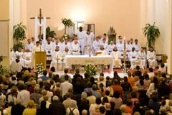
A Memorial
Notes:
The Holy Mass is a memorial for us to call to mind Jesus death for us.

Slide 8
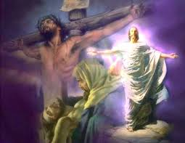
Resurrection of Jesus
Death
of Jesus

Slide 9
The Chief Priest celebrating Mass is the Risen Christ who is present in the Eucharist.

Slide 10
The Holy Mass is a Perfect Prayer

Slide 11
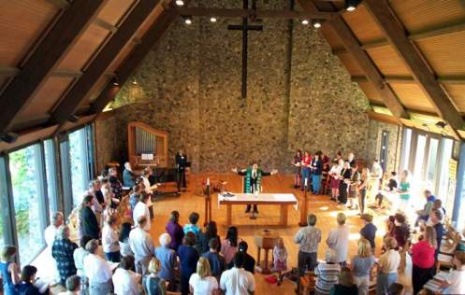
4 Ends of the Holy Mass
1. It is an act of Supreme Worship; it is Christs greatest gift to us – People with nothing to offer have been given a sacrifice of infinite value.

Slide 12
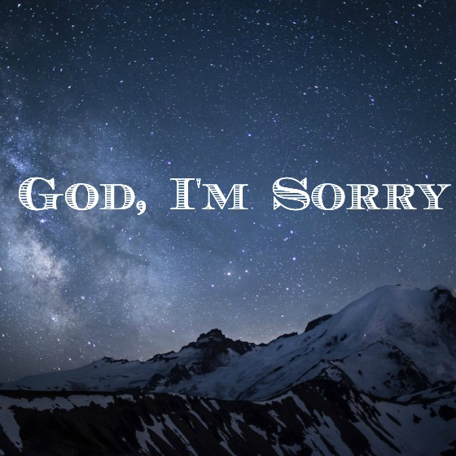
4 Ends of the Holy Mass
3. The Mass is a means of making satisfaction for our sins. We pray, “Lamb of God, you take away the sins of the world, Have mercy on us. Lam of God, you take away the sins of the world, have mercy on us, Lamb of God, you take away the sins of the world, Grant us Peace.”

Slide 13
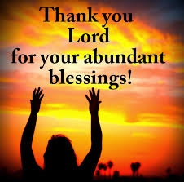
4 Ends of the Holy Mass
2. The Mass is a prayer of thanksgiving; “Eucharist” actually means “Thanks Giving” – We have so many gifts that we need to give thanks to God for – our lives and everything connected to it. And we Thank God for Jesus.

Slide 14
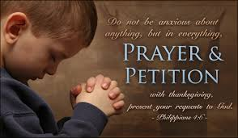
4 Ends of the Holy Mass
4. The Mass is the greatest means of Petitioning to the Father for graces for ourselves and others.

Slide 15
A C T S
ADORE CONFESS THANK SUPPLICATE

Slide 16
Jesus’ workers continue to do this in memory of Him

