Slide 1
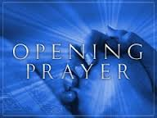

Slide 2
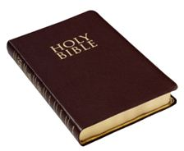
John: 6
Notes:
Read Jn: 6

Slide 4
Did the disciples believe in what Jesus said?
Yes they did, as Jesus had just performed the miracle of turning few bread and fish to feed 5 thousands people.

Slide 5
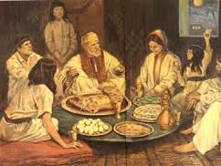
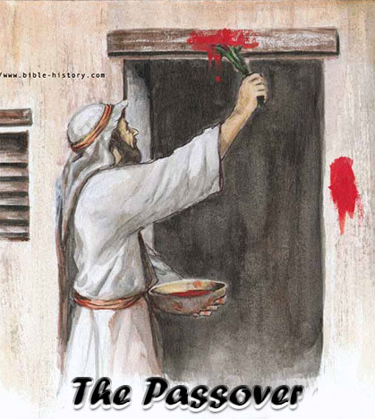
Pharoah was stubborn and would not let the Hebrews leave.
God instructed the Hebrews through Moses to offer a special sacrifice that night; a spotless lamb, one for each family; and mark their doorposts with the blood of the lamb.
Angel of death passed over all houses with the sign and killed all the first borns whose door posts were not marked.

Slide 6
Our God Saves
God saved the Hebrews even thought they were sinners.
God saves us even though we sin, through the crucifixion and death of our Lord Jesus Christ.

Slide 7
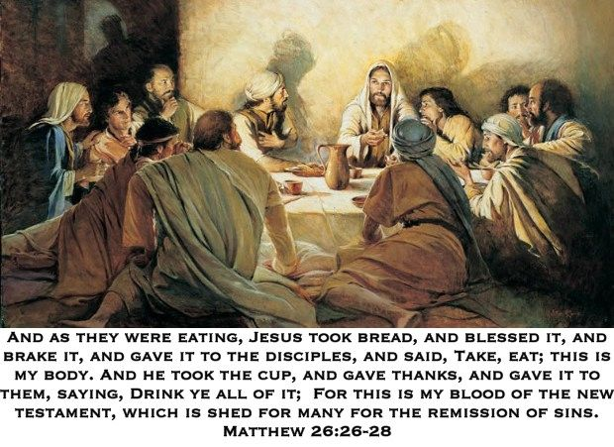
The Last Supper

Slide 8
Offering a sacrifice has 4 purposes
To adore God
To thank Him
To make up for sin
To ask Him for help

Slide 9
No sacrifice was good enough to atone for our sins.
And so..
God gave His only Son to do that job.
And Jesus could have at any point, come down from the cross, but he chose to suffer the pain and laid down His life for our sake.

Slide 10
Oblation
A total offering of a victim or gift in sacrifice

Slide 11
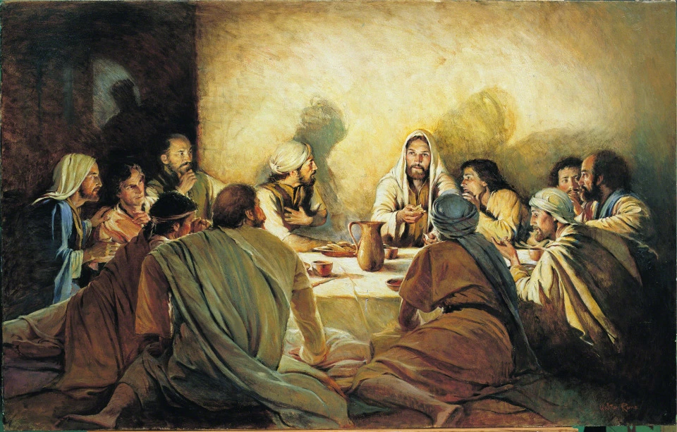
Transubstantiation
Notes:
Debrief the changing of the substance of bread and wine into Jesus body and blood.
Stayed same in appearance, but changed in the underlying reality.
It also referred to Jesus dying for us to free us from our sins.

Slide 12
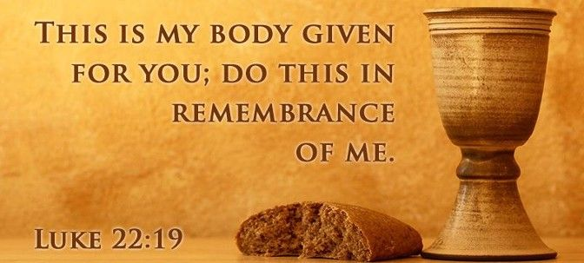

Slide 13
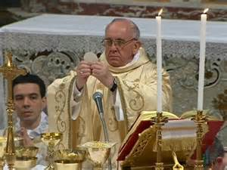
Jesus’ workers continue to do this in memory of Him

