Slide 1
Prayer

Slide 2
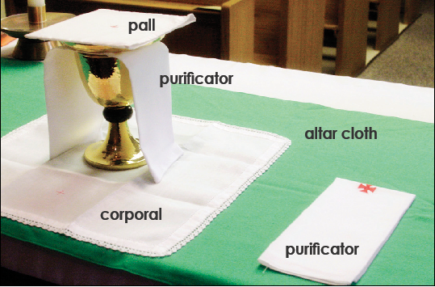

Slide 4
Mass is the mystery of Christ’s death and Resurrection
CHAPTER 21
NEW LIFE

Slide 5
Joseph of Arimathea Taking the body of Jesus

Slide 6
Resurrected Jesus
Mt 28: 1-10
John 20 : 19- 23
John 20 : 24- 29
John 21 : 15 – 17
Acts 2- Pentecost – Birthday of the Church

Slide 7
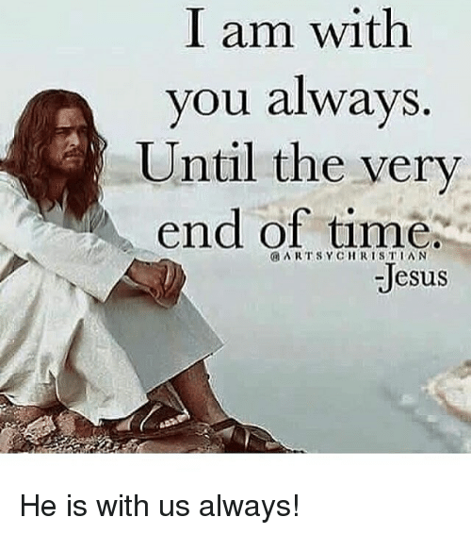

Slide 9
Evaluation
Greek word eucharistia meaning ………………..
Jesus stayed on earth ……………..days after the Resurrection
………………is the first pope
The birthday of the Church is known as ……………….
What did Jesus ask Peter three times ?
Forty days after resurrection what happened to Jesus?
Who took the body of Jesus and buried ?
Why did Jesus remain on earth for forty days after his Resurrection ?

