Slide 1
prayer

Slide 2
Chapter – 12 Charity Toward All

Slide 3
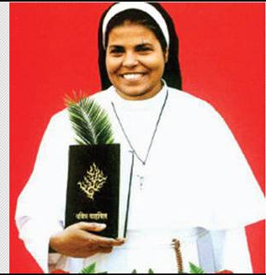
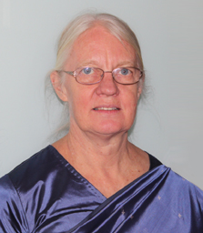
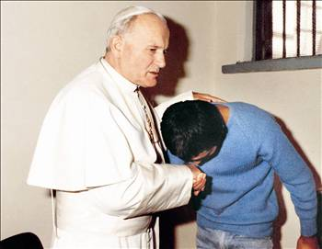
Blessed Rani Maria
Mrs. Gladys Staines
Pope John Paul II
Forgiveness

Slide 5
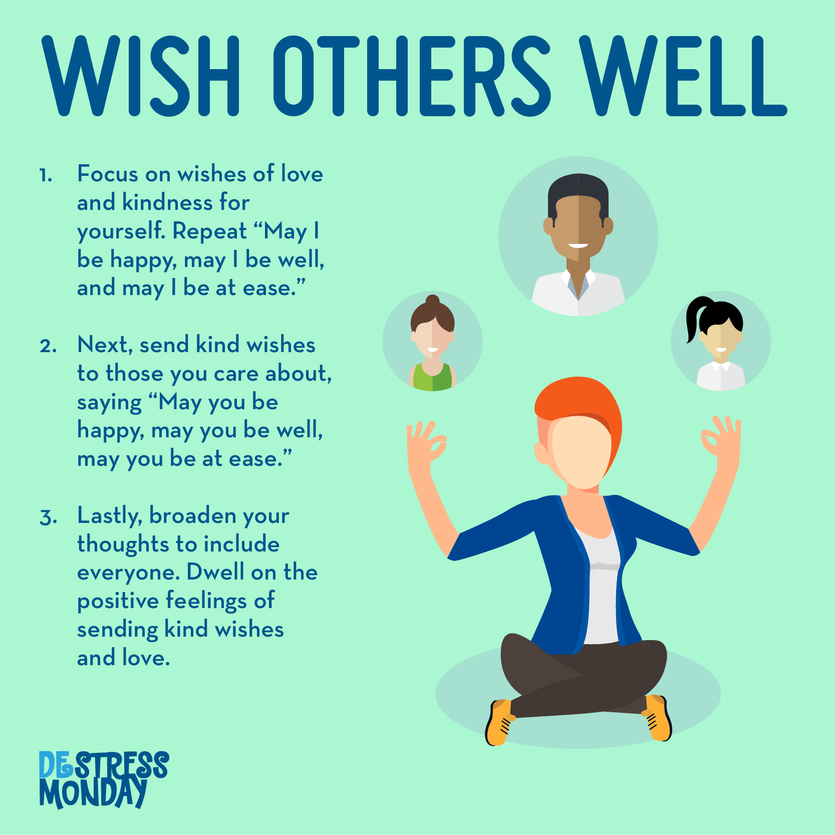
Good will
I wish everyone well
Treat Everyone well
Have Good will, Kind attitude
Good will is willed love not an
emotional love

Slide 6
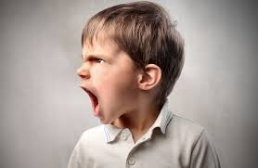
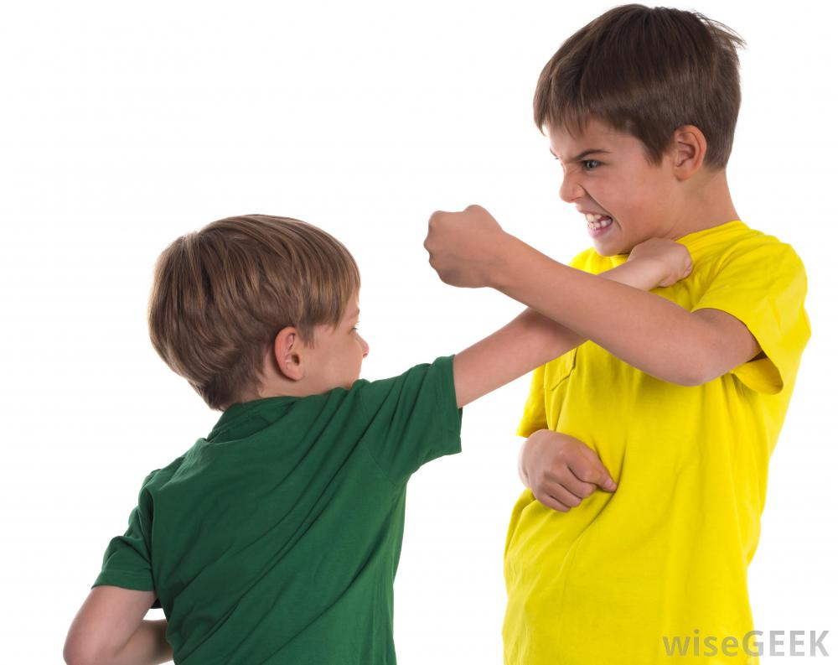
ANGER

Slide 7
Must not have unrighteous anger
Do not curse
Do not spread lies
Do not harm the reputation of anybody
Do not fight
Our words spread quickly, we cannot take them back

Slide 8
Righteous Anger

Slide 9
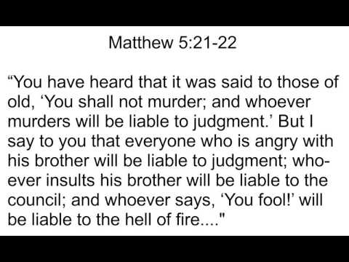
HATRED

Slide 10
Stop harboring anger or hatred
Try to reconcile with the person
Do not take revenge
Avoid talking about the person and spreading rumors
Pray for the person
Have good will towards all

Slide 11
SCANDAL
Scandal is a fully conscious and deliberate bad example or encouragement to lead another person into sin.

Slide 13
What is the Fifth Commandment
What does fifth commandment call us to do ?
What is scandal ?
Give few examples of people who forgave others?
Recall in your life where you have forgiven others or others have forgiven you.

