Slide 1
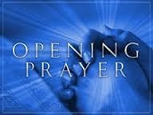

Slide 2
Who has authority over us?
Parents
State – Government
Church
God the Father, Jesus, Holy Spirit

Slide 3
Church Authority – Our Fathers in Faith

Slide 4
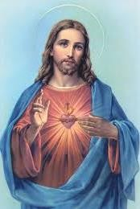
Who gave the Church its mission to save souls, to teach all men the truths of Faith, and to govern the Church as a body?

Slide 5
True or False?
The Church is the means Jesus chose to remain with us always and to lead us to His Heavenly Kingdom, our final goal.

Slide 6
Group Answers
Who is the Head or Ruler of the Church?
Who has given the authority to the pope to rule the Church on his behalf?
How many Popes do we have including the current one?
1.
Jesus
2.
Jesus
3.
266
What’s the name of our current Pope? 4.
What’s the name of our Apostolic
Pope
Francis
Administrator of the Vicariate of Northern Arabia?
5.
Bishop
Aldo
Berardi

Slide 7
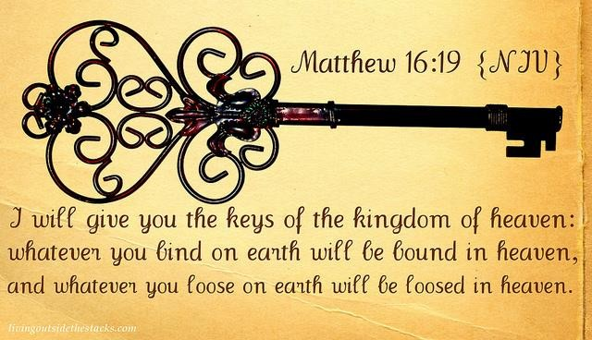
Who said to whom?
Jesus to Peter

Slide 8
Our First Pope
Our Current Pope

Slide 9
To preach the Gospel and lead all people to holiness.
Who is responsible for doing this?

Slide 10
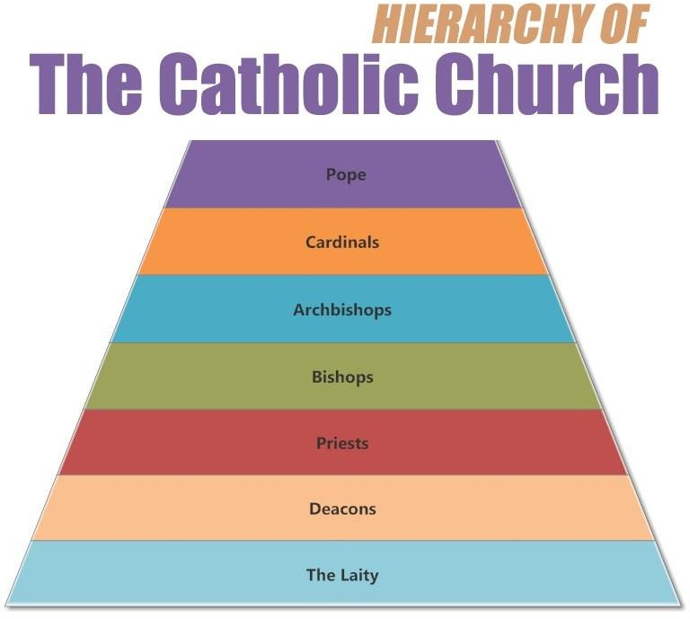

Slide 11
The Pope makes sure Faith is taught to us correctly through his speeches, encyclicals, letters and declarations.

Slide 12
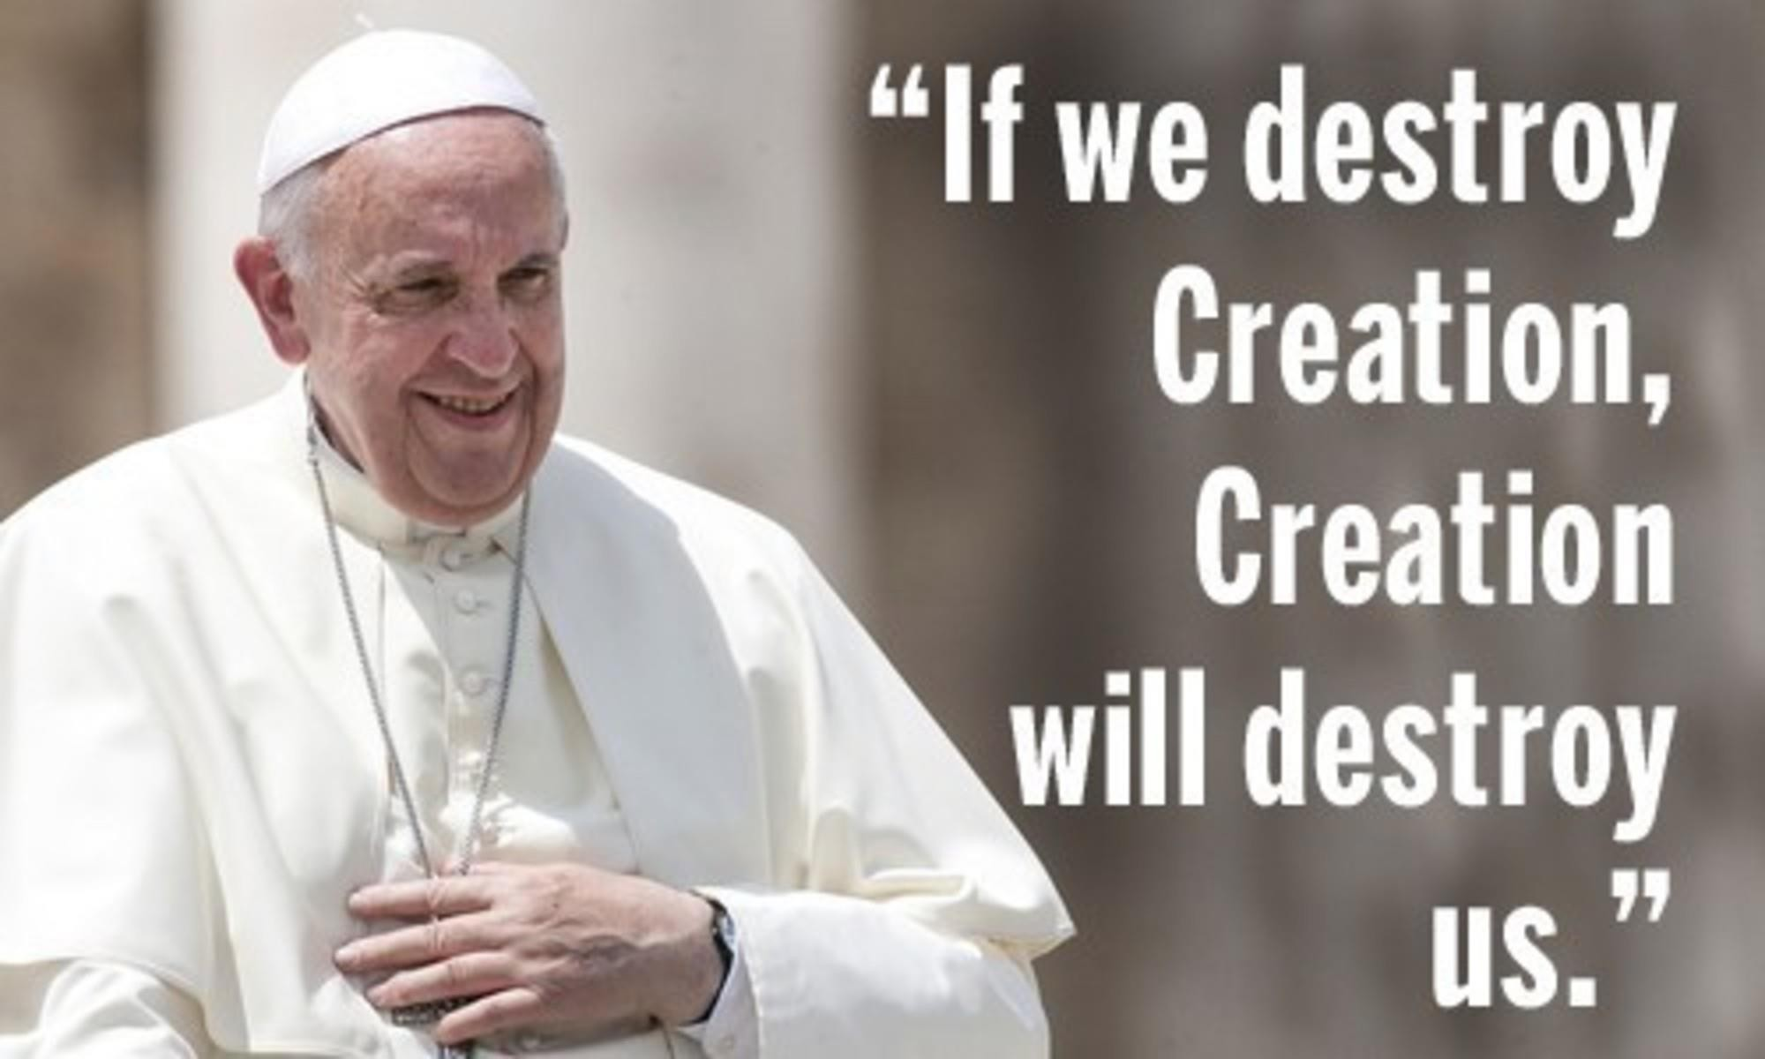

Slide 13
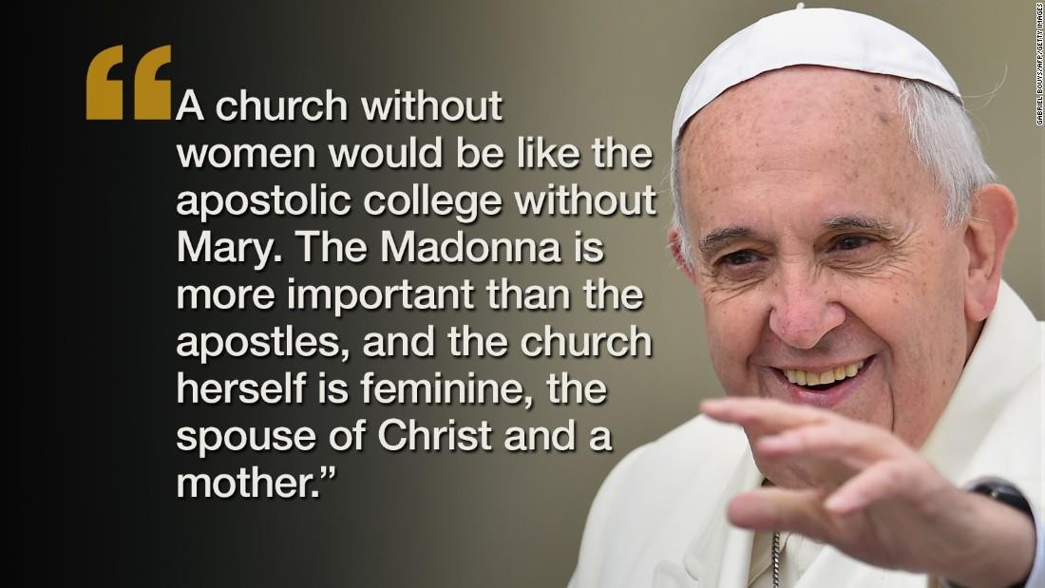

Slide 14
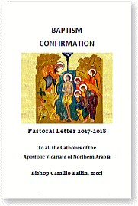
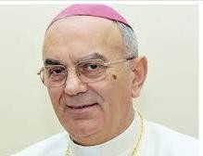
Bishop Camillo Ballin Pastoral Letter

Slide 15
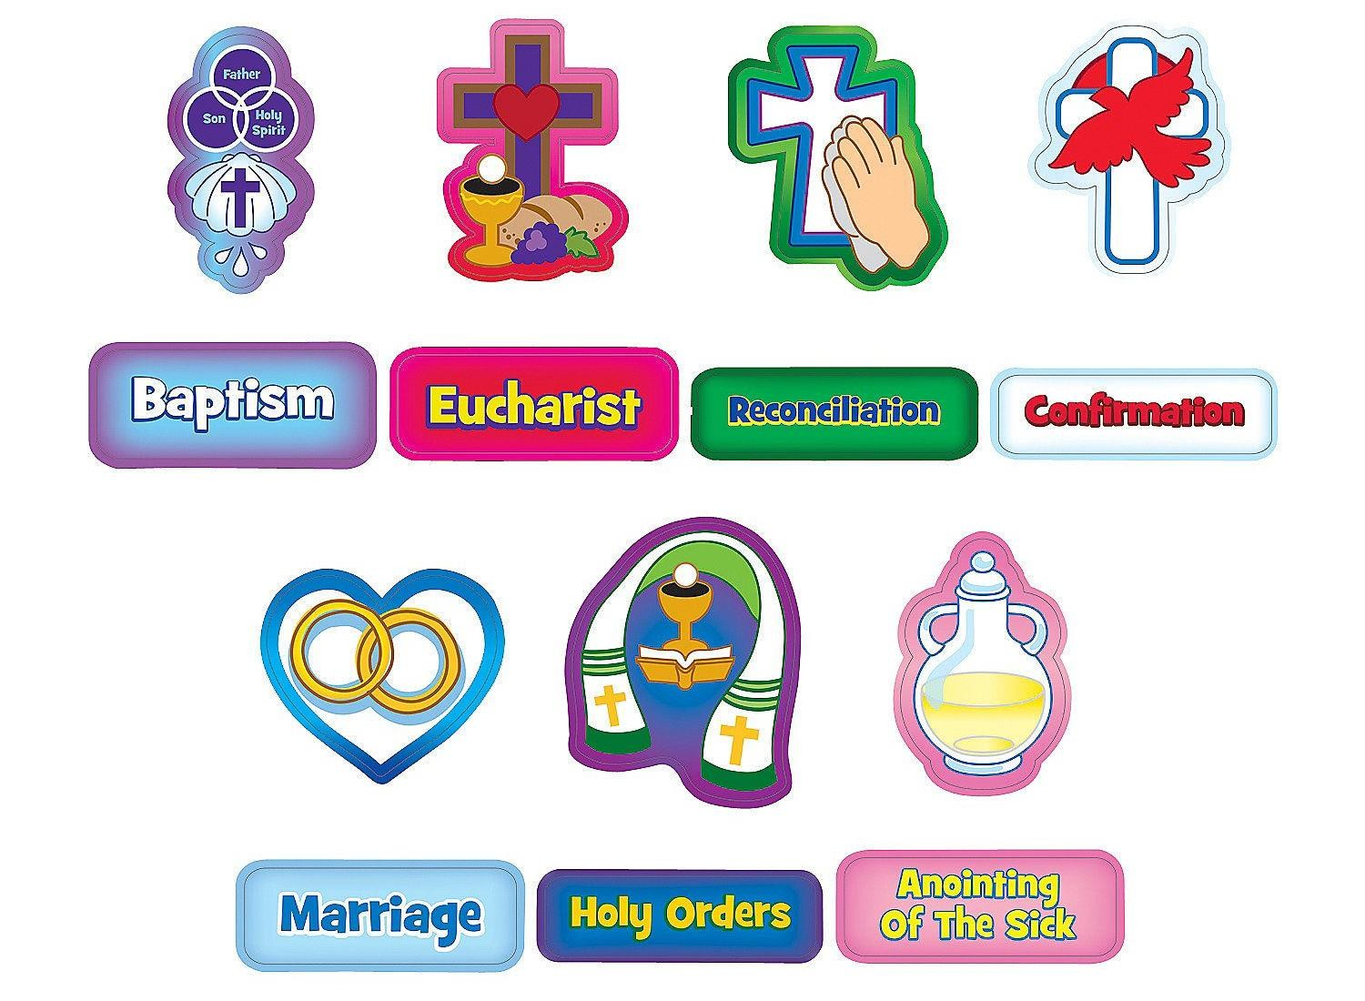

Slide 16
The Church determines the rules and regulations that are needed for the administering of the Sacraments in a consistent manner.

Slide 17
7 Sacraments
Baptism: Mt 28:18-20
Eucharist: Mk 14:22-25
Confirmation: Jn 7:37-39; 14:26; 20:22; Acts
1:8; 2:4
Penance: Jn 20:21-23
Anointing of the Sick: Mk 6:13; Jas 5:14
Matrimony: Mt 19:4-6; Jn 2:1-11
Holy Orders: Lk 22:19; Jn 13:1-15; Acts 6:6

Slide 18
Baptism: Mt 28:18-20
And Jesus came and spoke to them, saying, “All authority has been given to Me in heaven and on earth. Go therefore and make disciples of all the nations, baptizing them in the name of the Father and of the Son and of the Holy
Spirit, teaching them to observe all things that I have commanded you; and lo, I am with you always, even to the end of the age.” Amen.

Slide 19
Eucharist:
Jesus Institutes the Lord’s Supper
Mk 14:22-25
- And as they were eating, Jesus took
bread, blessed and broke it, and gave it to them and said, “Take, eat; this is My body.” Then He took the cup, and when He had given thanks He gave it to them, and they all drank from it. And He said to them, “This is My blood of the new covenant, which is shed for
many. Assuredly, I say to you, I will no longer drink of the fruit of the vine until that day when I drink it new in the kingdom of God.”

Slide 20
Confirmation:
The Promise of the Holy Spirit
Jn 7:37-39
- On the last day, that great day of the feast, Jesus
stood and cried out, saying, “If anyone thirsts, let him come to Me and drink. He who believes in Me, as the Scripture has said, out of his heart will flow rivers of living water.” But this He spoke concerning the Spirit, whom those believing in Him would receive; for the Holy Spirit was not yet given, because Jesus was not
yet glorified.
Jn 14:26
- But the Helper, the Holy Spirit, whom the Father
will send in My name, He will teach you all things, and bring to your remembrance all things that I said to you.
Jn 20:22
- And when He had said this, He breathed on them, and
said to them, “Receive the Holy Spirit.
Acts 1:8
- But you shall receive power when the Holy Spirit has
come upon you; and you shall be witnesses to Me in Jerusalem, and in all Judea and Samaria, and to the end of the earth.”
Acts 2:4
- And they were all filled with the Holy Spirit and began to
speak with other tongues, as the Spirit gave them utterance.

Slide 21
Penance:
Jn 20:21-23
- So Jesus said to them again, “Peace
to you! As the Father has sent Me, I also send you.” And when He had said this, He breathed on them, and said to them, “Receive the Holy Spirit. If you forgive the sins of any, they are forgiven them; if you retain the sins of any, they are retained.”

Slide 22
Anointing of the Sick: Mk 6:13; Jas
5:14
- And they cast out many demons, and
Mk 6:13
anointed with oil many who were sick, and healed them.
for the elders of the church, and let them pray over him, anointing him with oil in the name of the Lord.
Jas 5:14
- Is anyone among you sick? Let him call

Slide 23
Matrimony:
Mt 19:4-6
- And He answered and said to
them, “Have you not read that He
who made them at the beginning ‘made them
male and female,’ and said, ‘For this reason a man shall leave his father and mother and be joined to his wife, and the two shall become one flesh’? So then, they are no longer two but one flesh.
Therefore what God has joined together, let not
man separate.”

Slide 24
Matrimony:
Jn 2:1-11
- On the third day there was a wedding in Cana of Galilee, and
the mother of Jesus was there. Now both Jesus and His disciples were invited to the wedding. And when they ran out of wine, the mother of Jesus said to Him, “They have no wine.” Jesus said to her, “Woman, what does your concern have to do with Me? My hour has not yet come.” His mother said to the servants, “Whatever He says to you, do it.” Now there were set there six waterpots of stone, according to the manner of purification of the Jews, containing twenty or thirty gallons apiece. Jesus said to them, “Fill the waterpots with water.” And they filled them up to the brim. And He said to them, “Draw some out now, and take it to the master of the feast.” And they took it. When the master of the feast had tasted the water that was made wine, and did not know where it came from (but the servants who had drawn the water knew), the master of the feast called the bridegroom. And he said to him, “Every man at the beginning sets out the good wine, and when
the guests have well drunk, then the inferior. You have kept the good wine
until now!” This beginning of signs Jesus did in Cana of
Galilee, and manifested His glory; and His disciples believed in Him.

Slide 25
Holy Orders:
Lk 22:19- And He took bread, gave thanks and broke it, and gave it to them, saying, “This is My body which is given for you; do this in
remembrance of Me.”
Acts 6:6 –

Slide 26
Holy Orders:
Jn 13:1-15 – Now before the Feast of the Passover, when Jesus knew that His hour had come that He should depart from this world to the Father, having loved His own who were in the world, He loved them to the end. And supper being ended, the devil
having already put it into the heart of Judas Iscariot, Simon’s son, to betray Him, Jesus, knowing that the Father had given all things into His hands, and that He had come from God and was going to God, rose from supper and laid aside His garments, took a towel and girded Himself. After that, He poured water into a basin and began to wash the disciples’ feet, and to wipe them with the towel with which He was girded. Then He came to Simon Peter. And Peter said to Him, “Lord, are You washing my feet?” Jesus answered and said to him, “What I am doing you do not understand now, but you will know after this.” Peter said to Him, “You shall never wash my feet!” Jesus answered him, “If I do not wash you, you have no part with Me.” Simon Peter said to Him, “Lord, not my feet only, but also my hands and my head!” Jesus said to him, “He who is bathed needs only to wash his feet, but is completely clean; and you are clean, but not all of you.” For He knew who would betray Him; therefore He said, “You are not all
clean.” So when He had washed their feet, taken His garments, and sat down again, He said to them, “Do you know what I have done to you? You call Me Teacher and Lord, and you say well, for so I am. If I then, your Lord and Teacher, have washed your
feet, you also ought to wash one another’s feet. For I have given you an example, that
you should do as I have done to you.

Slide 28
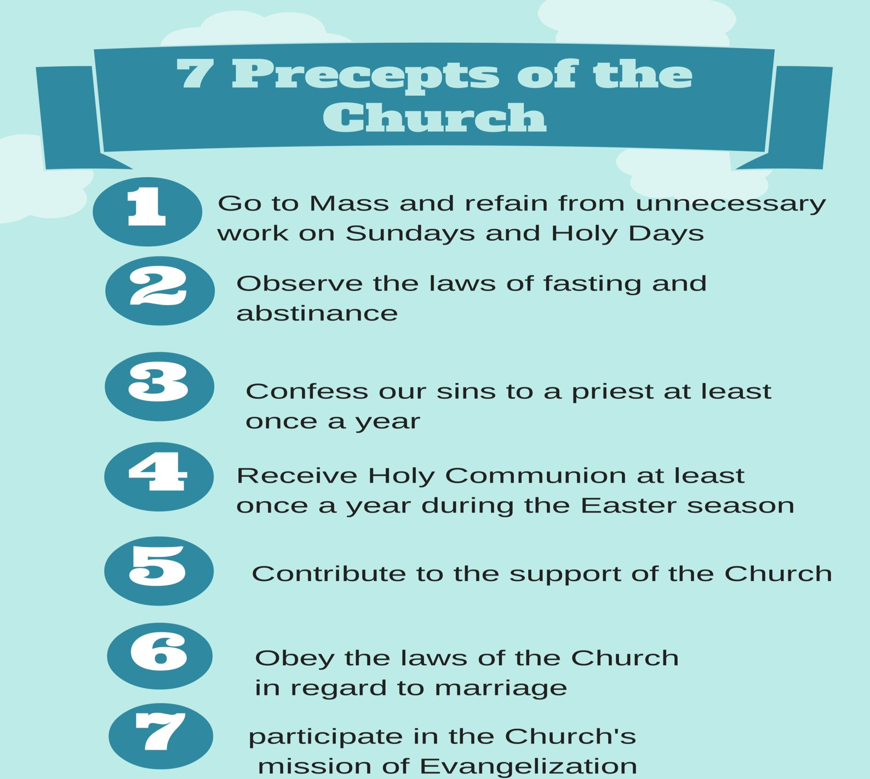

Slide 29
Quizzez

